Slide 1
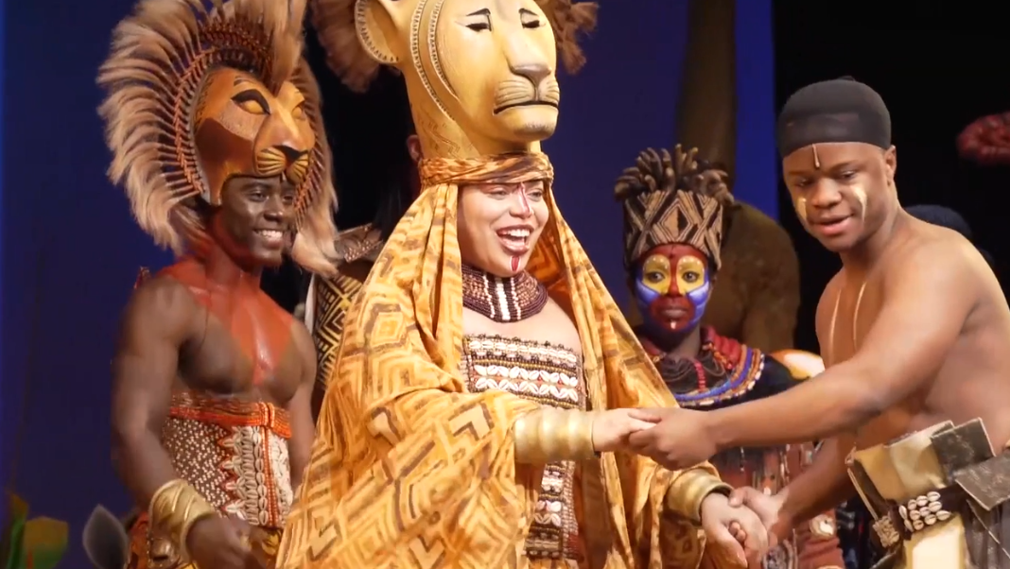

Slide 2
BOOK
Arguably the most important aspect of the musical!
The music ain’t enough to save a book musical. Except:
Concept musicals
Jukebox musicals
We are only going to focus on writing original musicals
Permissions and rights for adaptations are a whole ‘nother topic
The demographic of our class are novelists, playwrights, and poets
Assumption: Everyone in our class understands basic storytelling structure, characters, chapters/scenes, dialogue, genre, themes, etc.
Disclaimer: Musical writers, especially those who take on many roles like David, need refresher classes on the basic storytelling due to mental dilution and not enough headspace

Slide 3
BOOK (cont.)
Character-Driven Musical (plot supports the characters) [streets]
The audience focuses on the conflict that pushes the musical
The supporting characters should have as much depth as the lead(s)
Protagonist and antagonist are the most driven
Plot-Driven Musical (characters support the plot) [freeway]
The audience focuses on the characters in the world of the musical
3-Act Breakdown with an intermission in between Act I and II
Motifs must plant a seed and be watered
Leitmotifs often come with a melodic phrase and/or theatrical element

Slide 4
BOOK OF MUSICAL VS BOOK OF NOVEL What musicals add to/SUBTRACT from novels:
What is added?
Collaborations
Music
“Show not tell” characterizations
Self-respect
What is subtracted?
Time
Unlimited intermissions
Sweet silence
Familial respect (and society’s)

Slide 5
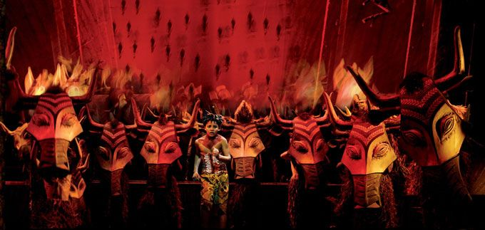
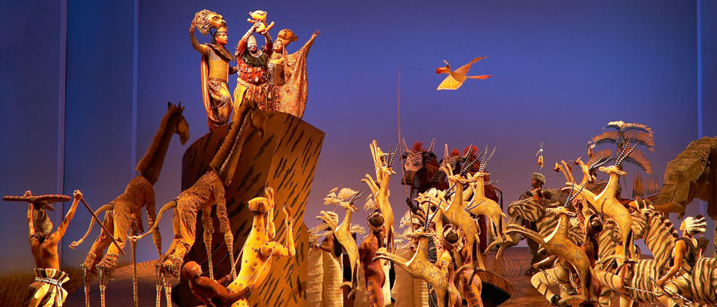
First 2 MUSICAL PLOT POINTS
1. Opening Number
2. Inciting incident

Slide 6

OPENING NUMBER
The worldbuilding song; it lays down to you the:
Character(s)
Setting(s)
Most of the time, it starts at stasis
Musicality & Theatricality
Tone
Genre(s) of music
Choreography
Anthem

Slide 7
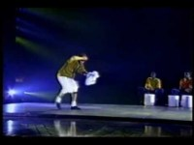

Slide 8
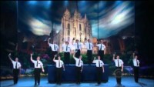

Slide 9


Slide 10
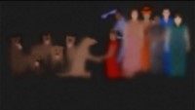

Slide 11
DON’T WORRY!
Opening numbers are almost always written last… (adaptations may vary this fact)
Like storytellers of any medium, you do not truly know your story until many drafts later
Composers want to have a finale and reprise that is set in stone and not constantly reworked
Composers also want to compile the score into a comprehensive mix

Slide 12

INCITING INCIDENT
Inciting incidents must establish clear goals for the hero (and the audience)
The inciting incident launches a series of trials that comprise the rising action of the book
If the story is “once upon a time something happened”, then the inciting incident is the “something” that kickstarts the story
It is not always that simple
Theatre troupe: “Once upon a time, a theatre is about to be bulldozed. Then the community came together.” (often fiction)

Slide 13
UGH, CAPITALISM. but help is pretty socialized
Musicals take years of effort. You should be open with the story you want to tell.
There are helpers around.

Slide 14

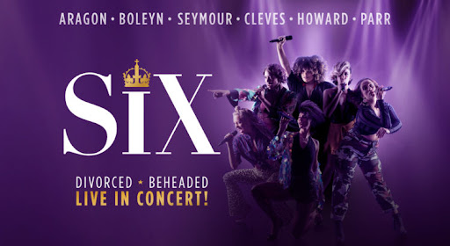
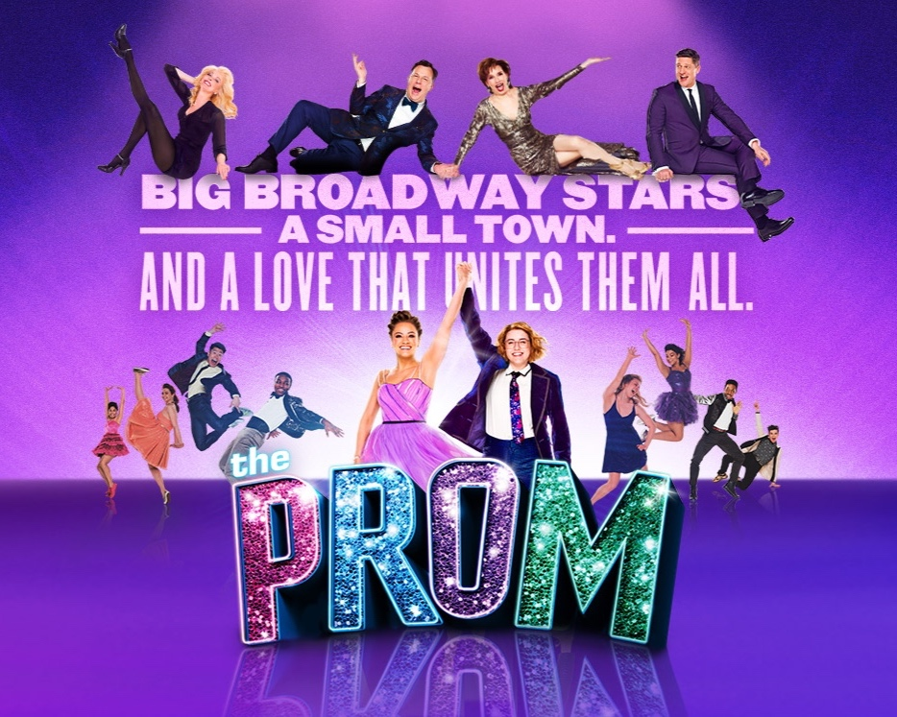
TaglineS

Slide 15
SYNOPSES
“(The protagonist) wants something (the story goal) and goes after it against all odds and obstacles (the antagonist and the conflict).”
Example: Simba wants to be the King of the Pride Lands and goes after it by taking down his uncle Scar and their pack of hyenas.
Say no more and have interested artists ask for more details
If you answer that what the artist is asking of is missing, they may know other artists who fill the void

Slide 16

Tagline: The whole Universe is a family drama.
David’s Synopsis: Spend an eternity in the family musical of epic proportions. ELLIPSES is the cosmology mythology that stars Singularity and their Galaxy children and follows their quest to undo the Big Bang, after their family dog Gravity sets it off.

Slide 17
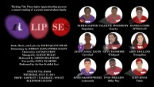

Slide 18
Tagline: The whole Universe is a family drama.
David’s Synopsis: Spend an eternity in the family musical of epic proportions. ELLIPSES is the cosmology mythology that stars Singularity and their Galaxy children and follows their quest to undo the Big Bang, after their family dog Gravity sets it off.
Ruly Synopsis: JD (the protagonist) wants to become an independent adult and a(p)parent (one of the story goals), so JD incapacitates their parent Singularity to escape and venture out with their dog Gravity against their siblings’ wishes (the antagonists and the conflict).

Slide 20
BREAKOUT: HOW HAVE your law breaker BROKEN THE WORLD/stasis?
Present your team’s inciting incident at 2:10PM Eastern
Novelist: Write a synopsis then write a tagline, based on your team’s inciting incident.
Playwright: Write a sample of the stage directions happening within your team’s inciting incident.
Poet: Write the inner monologue of your team’s protagonist.

Slide 21

BREAKIN:
TO
SONG!

Slide 22
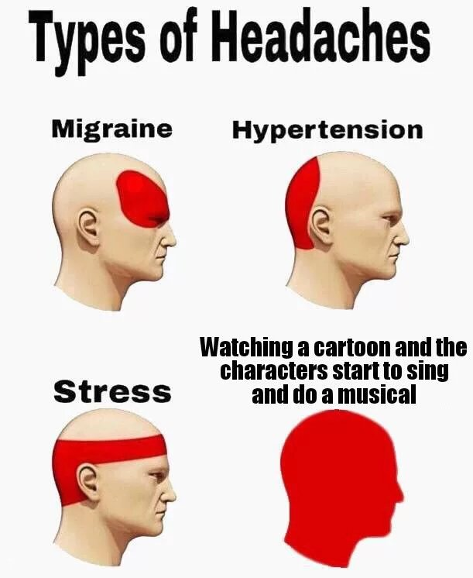
HOW TO NOT MAKE MORE PEOPLE HATE MUSICALS
Actually…
David Quang Pham is not qualified to teach how to or how not to break into song
Nor does he care if he annoys the masses
Okay, maybe he does but he pretends not to
It is just too fun to break out into song
He is not nearly a musical writer as he is an opera one

Slide 23
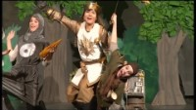
What’s the point of a theatrical song?
♫ establishes the setting
♫ creates the mood and ambiance
♫ conveys a strong emotional undertone
♫ develops the character
♫ expresses the conflict
♫ provides comic relief
♫ gives an anthem
♫ pushes the plot

Slide 24
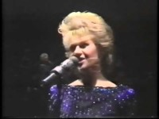

Slide 25
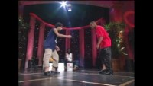

Slide 26
LYRICS
Musical considerations:
Action
Argument and (Single) Thesis
Diction and Rhetoric
Rhyme
Verse
David’s beliefs: Lyrics are lyrics through the ears of the beholder and an extension of the beholder’s life.
David and many composer’s skillset: Any initial lyrics will do. Don’t worry too much about the first draft of a song. It will be a back-and-forth relationship builder between the composer and lyricist.

Slide 27
WORDS OF SONG and WORDS OF POEM
Musical Number
Independent Poem
It is usually in service of a larger story
It is oftentimes the whole story
The character who sang this is “clever”
The poet who wrote the poem is “clever.”
*David is not a poet, so consider talking to a real poet about the points above
*David is a lyricist in both experimental and commercial orbits, so take it however
Mostly everything

Slide 28
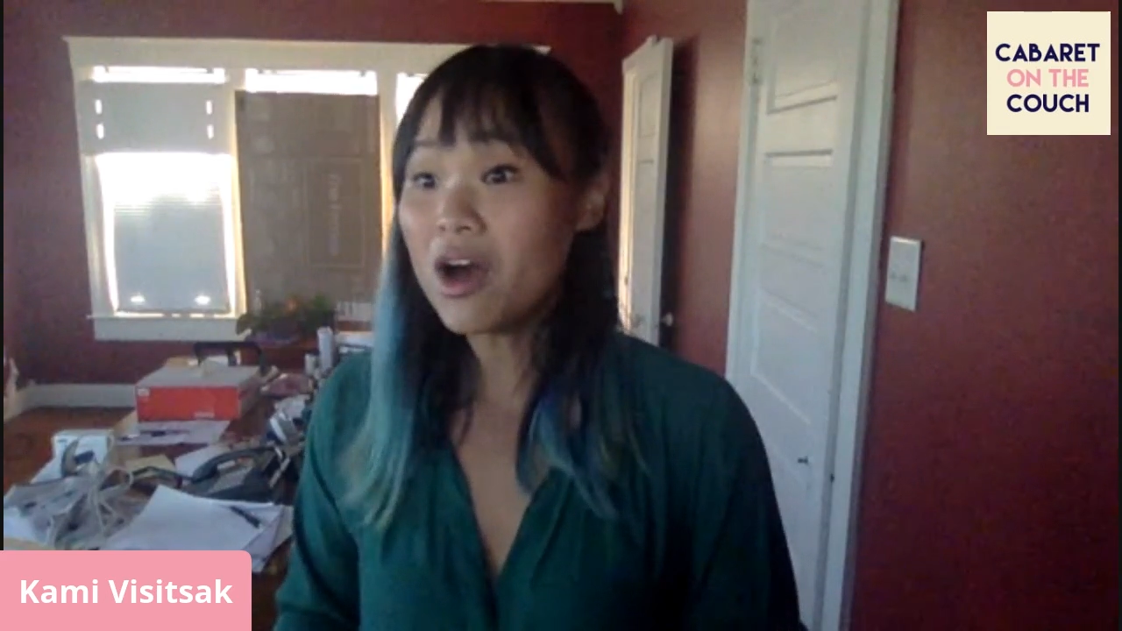
PHYS-LYRICS
Where do we begin…? “Valence” sung by Quark from TOUR
“Spin is an odd magnetic property encompassing quantum electromagnetism theo— really, we should 'dress the matter here. I need to eigenstate the up-down observable. You’re always in my space? Spacetime fabrication brings about limitations, so let’s move to state formation, mixed valence within femtoseconds, hear with holes in scantrons. Think of inside-outside your matters, you’ll figure out your charge and your configuration. There’s something to being noble, guess. I’ll stop with surveillance when this basic unit just quits taking energy! They’ll get electrons. They’ll group the elements. They’ll configurate.”

Slide 29


Slide 30
KEEP IN MIND THE VOCALISTS
Ease in pronunciation, articulation, or in flow
Placement of vowel sounds and consonants to facilitate such ease
Coordination of sound with range
Regard for how the performer must use their tongue, teeth, and breath; affected by personal experiences from but not limited to:
Age
Diet
Health
Upbringing

Slide 31
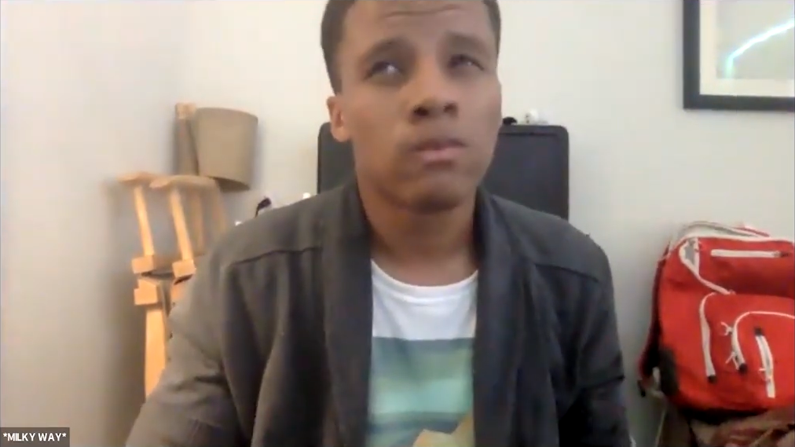
ASTRO-LYRICS
“Warp, Waves, and Wrinkles” sung for Milky Way from ELLIPSES
“Milky Way’s on their own. All alone. Know that for us at home. You’re the only way forward, through warp, waves, and wrinkles.”
“Warp, Waves, and Wrinkles” sung for Milky Way from ELLIPSES
“Milky Way’s on their own. All alone. Know that for us at home. You’re the only way forward, through warp, waves, and wrinkles.”

Slide 32
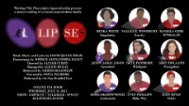

Slide 33
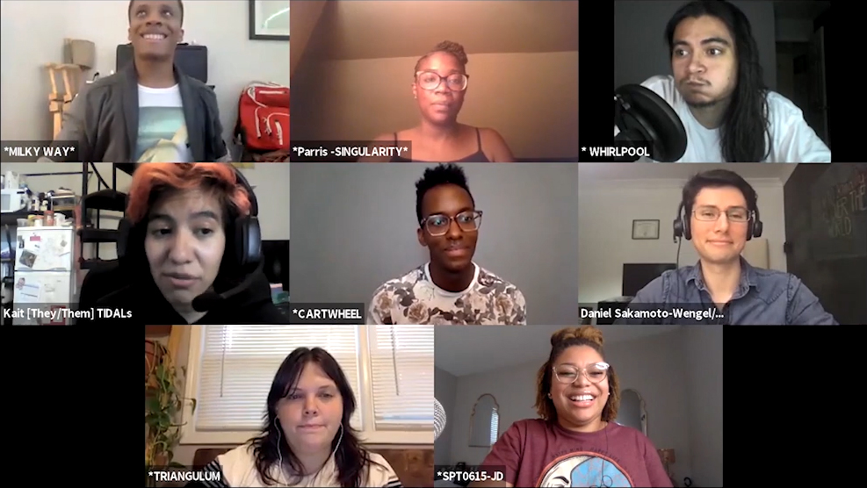
“Warp, Waves, and Wrinkles”
Structure: AABACACA
Where does Milky Way start and where do they end up?
What incites the change?
Where does the change happen?
What changes lyrically, musically after the change?
What is Milky Way feeling at the beginning vs the end?
How does the music support the journey?
What is the emotional undertone?

Slide 34
MUSIC SHOULD (de)mean THE LYRICS
David’s favorite type of songs: irony or double entendre songs
“Class” from CHICAGO (irony)
“I Know Things Now” from INTO THE WOODS (irony)
“Big Blonde and Beautiful” from HAIRSPRAY (double entendre)
“Anomaly is Everything” from ELLIPSES (irony)
“Time is Relative” from ELLIPSES (double entendre)
These sorts of irony and double entendre are easier for viewers to pick up from musicals compared to other storytelling mediums due to contrarian accompanying music and performances

Slide 35
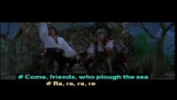

Slide 36
“I Want” song
Just as the name states, the song is about your protagonist’s or main characters’ wants
The “I Want” song clarifies the hero’s goals for the audience and points the way forward (the journey to attain the super-objective)
Like any story, you want the hero to get what they want; you push the audience’s wants, too

Slide 37


Slide 38
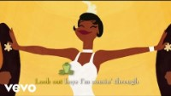

Slide 39
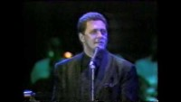

Slide 40


Slide 41
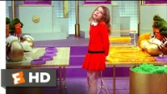

Slide 42
“I Want” song
Just as the name states, the song is about your protagonist’s or main characters’ wants
The “I Want” song clarifies the hero’s goals for the audience and points the way forward (the journey to attain the super-objective)
Like any story, you want the hero to get what they want; you push the audience’s wants, too
Even not-so-heroic characters have “I Want” songs
Easiest way to give depth to even supporting characters

Slide 43
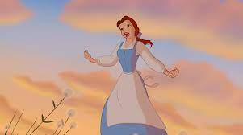

“I Want” songs
“I want adventure in the great wide somewhere.” – “Belle (Reprise)” by Belle from BEAUTY AND THE BEAST
“Oh, I just can’t wait to be king!” – “I Just Can't Wait to Be King” by Simba from LION KING
“Soon as I get home.” – “Soon As I Get Home” by Dorothy from THE WIZ
“And home's what Vanessa's runnin' away from...” – “It Won’t Be Long Now” for Vanessa from IN THE HEIGHTS
“Bring me no ring... Unless he's a matchless match.” – “Matchmaker, Matchmaker” by the five daughters from FIDDLER ON THE ROOF
“My future is an ellipse where my legacy is able to be the adult in the room...” – “Cutting Edge” by SPT0615-JD from ELLIPSES

Slide 44
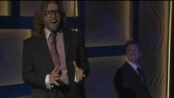

Slide 45
I want you to want!
Well, then how's anyone supposed to sympathize with you, [Law Breaker’s name]?

Slide 46
BREAKOUT: Why does your law breaker want?
Present your team’s story and “I Want” poem at 3:30PM Eastern
Novelist: Revise your synopsis. If you have time, write the plot summary up to the inciting incident.
Playwright: Write the stage directions and scene leading up to the “I Want” poem.
Poet: Write the “I Want” poem that the protagonist would monologue, whether alone or in a crowded world.

Slide 47
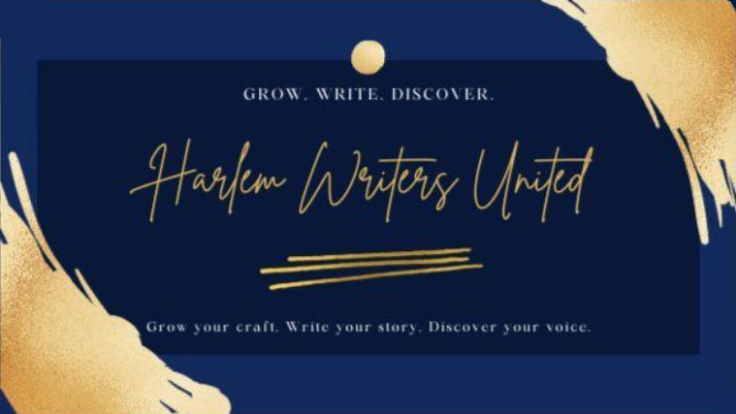
Where do I go from here?
Find your community!
Harlem Writers United

Slide 48

Where do I go from here?
Find your community!
Harlem Writers United
Working Title Playwrights

Slide 49

Where do I go from here?
Find your community!
Harlem Writers United
Working Title Playwrights
Share your work!
Musical Theatre Factory

Slide 50

Where do I go from here?
Find your community!
Harlem Writers United
Working Title Playwrights
Share your work!
Musical Theatre Factory
Nuyorican Poets Café

Slide 51

Where do I go from here?
Find your community!
Harlem Writers United
Working Title Playwrights
Share your work!
Musical Theatre Factory
Nuyorican Poets Café
Get a mentor!

Slide 52
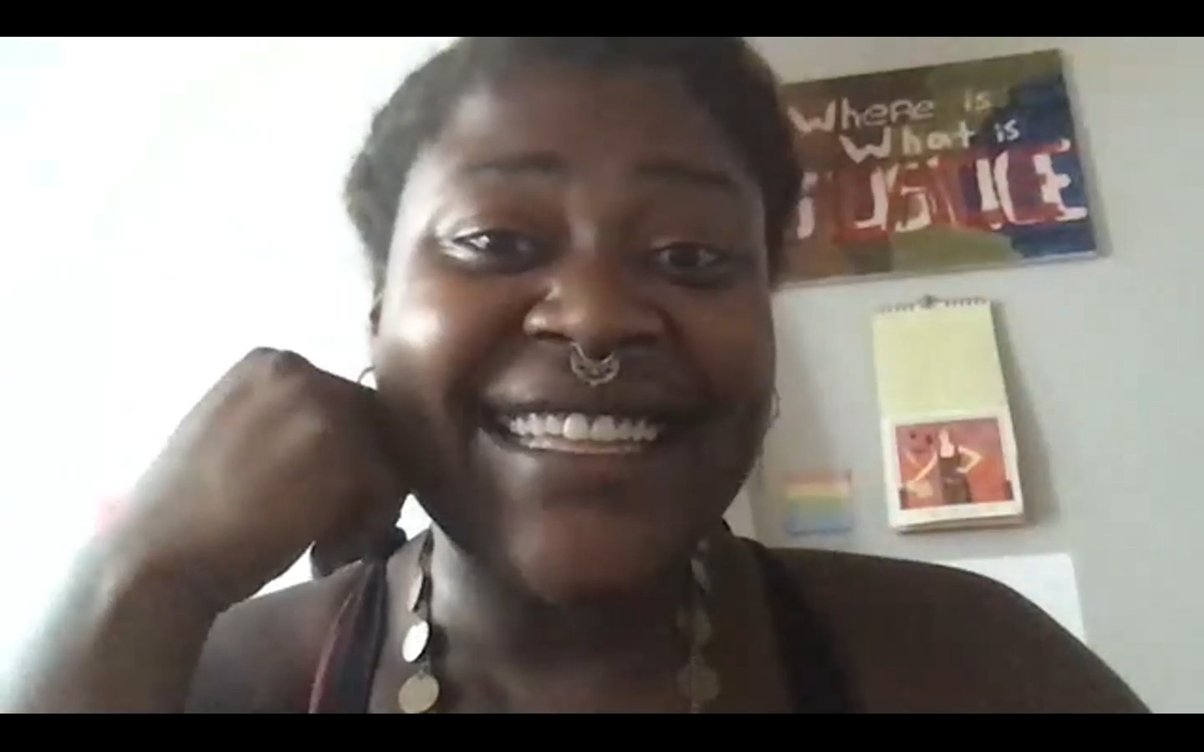
Where do I go from here?
Find your community!
Harlem Writers United
Working Title Playwrights
Share your work!
Musical Theatre Factory
Nuyorican Poets Café
Get a mentor!
David Quang Pham is here because of mentor Janelle Lawrence

Slide 53
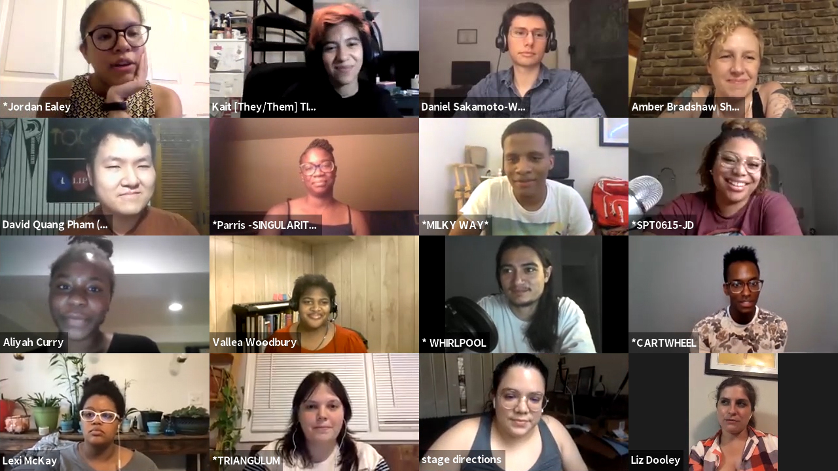
CONNECT!

Slide 54
THANK YOU, HARLEM!

